Slide 1
BigTable: A Distributed Storage System for Structured Data
Fay Chang, Jeffrey Dean, Sanjay Ghemawat, Wilson C. Hsieh, Deborah A. Wallach, Mike Burrows, Tushar Chandra, Andrew Fikes, Robert E. Gruber @ Google
Presented by Richard Venutolo

Slide 2
Introduction
BigTable is a distributed storage system for managing structured data.
Designed to scale to a very large size
  Petabytes of data across thousands of servers
Used for many Google projects
  Web indexing, Personalized Search, Google Earth, Google Analytics, Google Finance, …
Flexible, high-performance solution for all of Google’s products

Slide 3
Motivation
Lots of (semi-)structured data at Google
  URLs:
    Contents, crawl metadata, links, anchors, pagerank, …
  Per-user data:
    User preference settings, recent queries/search results, …
  Geographic locations:
    Physical entities (shops, restaurants, etc.), roads, satellite image data, user annotations, …
Scale is large
  Billions of URLs, many versions/page (~20K/version)
  Hundreds of millions of users, thousands or q/sec
  100TB+ of satellite image data

Slide 4
Why not just use commercial DB?
Scale is too large for most commercial databases
Even if it weren’t, cost would be very high
  Building internally means system can be applied across many projects for low incremental cost
Low-level storage optimizations help performance significantly
  Much harder to do when running on top of a database layer

Slide 5
Goals
Want asynchronous processes to be continuously updating different pieces of data
  Want access to most current data at any time
Need to support:
  Very high read/write rates (millions of ops per second)
  Efficient scans over all or interesting subsets of data
  Efficient joins of large one-to-one and one-to-many datasets
Often want to examine data changes over time
  E.g. Contents of a web page over multiple crawls

Slide 6
BigTable
Distributed multi-level map
Fault-tolerant, persistent
Scalable
  Thousands of servers
  Terabytes of in-memory data
  Petabyte of disk-based data
  Millions of reads/writes per second, efficient scans
Self-managing
  Servers can be added/removed dynamically
  Servers adjust to load imbalance

Slide 7
Building Blocks
Building blocks:
  Google File System (GFS): Raw storage
  Scheduler: schedules jobs onto machines
  Lock service: distributed lock manager
  MapReduce: simplified large-scale data processing
BigTable uses of building blocks:
  GFS: stores persistent data (SSTable file format for storage of data)
  Scheduler: schedules jobs involved in BigTable serving
  Lock service: master election, location bootstrapping
  Map Reduce: often used to read/write BigTable data

Slide 8
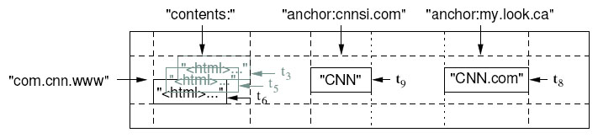
Basic Data Model
A BigTable is a sparse, distributed persistent multi-dimensional sorted map
(row, column, timestamp) -> cell contents
Good match for most Google applications

Slide 9
WebTable Example
Want to keep copy of a large collection of web pages and related information
Use URLs as row keys
Various aspects of web page as column names
Store contents of web pages in the contents: column under the timestamps when they were fetched.

Slide 10
Rows
Name is an arbitrary string
  Access to data in a row is atomic
  Row creation is implicit upon storing data
Rows ordered lexicographically
  Rows close together lexicographically usually on one or a small number of machines

Slide 11
Rows (cont.)
Reads of short row ranges are efficient and typically require communication with a small number of machines.
Can exploit this property by selecting row keys so they get good locality for data access.
Example:
  math.gatech.edu, math.uga.edu, phys.gatech.edu, phys.uga.edu
  VS
  edu.gatech.math, edu.gatech.phys, edu.uga.math, edu.uga.phys

Slide 12
Columns
Columns have two-level name structure:
    family:optional_qualifier
Column family
  Unit of access control
  Has associated type information
Qualifier gives unbounded columns
  Additional levels of indexing, if desired

Slide 13
Timestamps
Used to store different versions of data in a cell
  New writes default to current time, but timestamps for writes can also be set explicitly by clients
Lookup options:
  “Return most recent K values”
  “Return all values in timestamp range (or all values)”
Column families can be marked w/ attributes:
  “Only retain most recent K values in a cell”
  “Keep values until they are older than K seconds”

Slide 14
Implementation – Three Major Components
Library linked into every client
One master server
  Responsible for:
    Assigning tablets to tablet servers
    Detecting addition and expiration of tablet servers
    Balancing tablet-server load
    Garbage collection
Many tablet servers
  Tablet servers handle read and write requests to its table
  Splits tablets that have grown too large

Slide 15
Implementation (cont.)
Client data doesn’t move through master server. Clients communicate directly with tablet servers for reads and writes.
Most clients never communicate with the master server, leaving it lightly loaded in practice.

Slide 16
Tablets
Large tables broken into tablets at row boundaries
  Tablet holds contiguous range of rows
    Clients can often choose row keys to achieve locality
  Aim for ~100MB to 200MB of data per tablet
Serving machine responsible for ~100 tablets
  Fast recovery:
    100 machines each pick up 1 tablet for failed machine
  Fine-grained load balancing:
    Migrate tablets away from overloaded machine
    Master makes load-balancing decisions

Slide 17
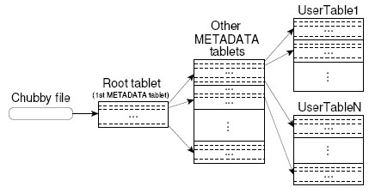
Tablet Location
Since tablets move around from server to server, given a row, how do clients find the right machine?
  Need to find tablet whose row range covers the target row

Slide 18
Tablet Assignment
Each tablet is assigned to one tablet server at a time.
Master server keeps track of the set of live tablet servers and current assignments of tablets to servers. Also keeps track of unassigned tablets.
When a tablet is unassigned, master assigns the tablet to an tablet server with sufficient room.

Slide 19
API
Metadata operations
  Create/delete tables, column families, change metadata
Writes (atomic)
  Set(): write cells in a row
  DeleteCells(): delete cells in a row
  DeleteRow(): delete all cells in a row
Reads
  Scanner: read arbitrary cells in a bigtable
    Each row read is atomic
    Can restrict returned rows to a particular range
    Can ask for just data from 1 row, all rows, etc.
    Can ask for all columns, just certain column families, or specific columns

Slide 20
Refinements: Locality Groups
Can group multiple column families into a locality group
  Separate SSTable is created for each locality group in each tablet.
Segregating columns families that are not typically accessed together enables more efficient reads.
  In WebTable, page metadata can be in one group and contents of the page in another group.

Slide 21
Refinements: Compression
Many opportunities for compression
  Similar values in the same row/column at different timestamps
  Similar values in different columns
  Similar values across adjacent rows
Two-pass custom compressions scheme
  First pass: compress long common strings across a large window
  Second pass: look for repetitions in small window
Speed emphasized, but good space reduction (10-to-1)

Slide 22
Refinements: Bloom Filters
Read operation has to read from disk when desired SSTable isn’t in memory
Reduce number of accesses by specifying a Bloom filter.
  Allows us ask if an SSTable might contain data for a specified row/column pair.
  Small amount of memory for Bloom filters drastically reduces the number of disk seeks for read operations
  Use implies that most lookups for non-existent rows or columns do not need to touch disk

Slide 23
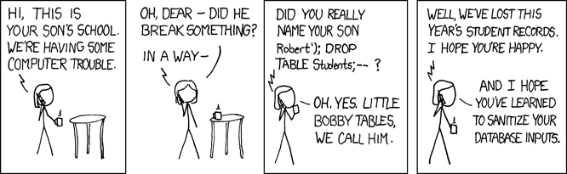
End
http://www.xkcd.com/327/

